Slide 1

Lights, Camera, Analytics!
10|03|16
Elizabeth Carnahan
Kristopher Korte
Brian Malloy
Noreen Nagji
Karthik Subramanian
Notes:
Brian

Slide 2
Agenda
1
Strategic Challenges
2
Metrics and Mental Models
3
Data and Analysis
4
Insights
5
Recommendation and Next Steps
Notes:
Brian

Slide 3

Strategic Challenges
Notes:
Brian

Slide 4



What factors are relevant in predicting box office revenue of a movie?
Our hypothesis is that movie production companies can predict revenues through careful selection of specific variables
1
9
3
5
11
2
$2,783,918,982
$1,274,234,980
$1,837,932,841
$1,519,479,547
$1,163,595,387
$2,207,615,668
Notes:
Brian 1:15
Hypothesis: Movie production companies can predict revenues through careful selection of specific variables

Slide 5

Metrics & Mental Models

Slide 6
Mental Model
Prior to running our regressions, we created a mental model of the variables that could significantly affect ticket sales
Critic Reviews
User Reviews
Word of Mouth Reception
User Votes
Budget
Ticket Sales
IMDB Score
Director
Genre
Actors
MPAA Rating
Face Numbers in Poster
Notes:
Prior to running our regressions, we created a mental model of the variable that could significantly affect ticket sales. One hypothesis was around the quantity of user reviews and the overall IMDB score. We linked “User Votes” and “IMDB Score” because we hypothesized that movies that were exceptionally good or exceptionally bad would be more likely to drive users to rate the film. With respect to budget, we expected there to be a correlation between director and budget, and actors and budget. Lastly, we hypothesized that genre and MPAA ratings would have a direct affect on the number of ticket sales.

Slide 7

Data and Analysis
Notes:
Kris

Slide 8






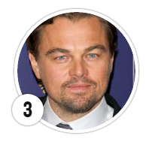
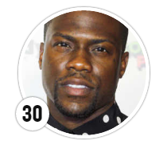
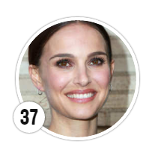
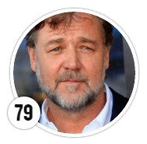


Data
We used complimentary datasets to create dummy variables and adjusted dollar amounts for an accurate comparison
5,044 Rows
2,695 Rows
US Films
English as Primary Language
Released in 1990 or Later
Eliminated duplicates
Eliminated incomplete rows
Eliminated films rated X & NC-17
Created 3 Tiers Based on Vulture Ranks (Actor) & AMC Ratings (Director)
Tier 1
Tier 2
Tier 3
Adjusted gross revenue for inflation using average ticket price per year of movie release
Ratings
Ex. G, PG, PG-13, R
Film Genres
Ex. Comedy, Drama, Horror
Actor/Director Tiers
Ex. Tier 1, Tier 2, Tier 3
Notes:
We started off at Kaggle and found a data set containing IMDb information that consisted of over 5000 rows of data.
The first thing we did was scrub the data by removing duplicates, eliminating movies released prior to 1990, and focused only on US films with English as the primary language.
As part of the data set, we were provided with the name of the director and the names of the three lead actors and/or actresses. In order to test our hypothesis that star power directly influenced the number of tickets sold, we created tiers based on rankings from Vulture and AMC.
In order to account for inflation, we took gross box office dollars and divided it by the average ticket price for films released in that year to get number of tickets sold and then multiplied by the average ticket price in 2016 to get an inflation-adjusted box office number.
Lastly, to prepare the data for our regressions, we created dummy variables for film rating, genre, and actor/director tier.

Slide 9
Analysis – Linear Regression
We used regression analysis to determine what factors contribute to a movie’s box office revenues
Regression
Model Prediction
Goodness of Fit Statistics
Test set (20% of data)
Training set (80% of data)
Ran a linear regression on log of ticket sales, second time eliminating all insignificant variables
Notes:
Karthik

Slide 10
Analysis – Linear Regression
We used regression analysis to determine what factors contribute to a movie’s box office revenues
Regression
Model Prediction
Goodness of Fit Statistics
Test set (20% of data)
Training set (80% of data)
Ran a linear regression on log of ticket sales, second time eliminating all insignificant variables
Used analysis to perform prediction for test data set
Goal: to predict ticket sales and box office revenues with accuracy
Notes:
Karthik

Slide 11
Analysis – Linear Regression
We used regression analysis to determine what factors contribute to a movie’s box office revenues
Regression
Model Prediction
Goodness of Fit Statistics
Test set (20% of data)
Training set (80% of data)
Ran a linear regression on log of ticket sales, second time eliminating all insignificant variables
Used analysis to perform prediction for test data set
Goal: to predict ticket sales and box office revenues with accuracy
Observations | 2145.000
Sum of weights | 2145.000
DF | 2133.000
R² | 0.509
Adjusted R² | 0.51
MSE | 1.891
RMSE | 1.375
MAPE | 7.24
DW | 0.842
Cp | 12.000
AIC | 1378.900
SBC | 1446.950
PC | 0.496
Notes:
Karthik

Slide 12
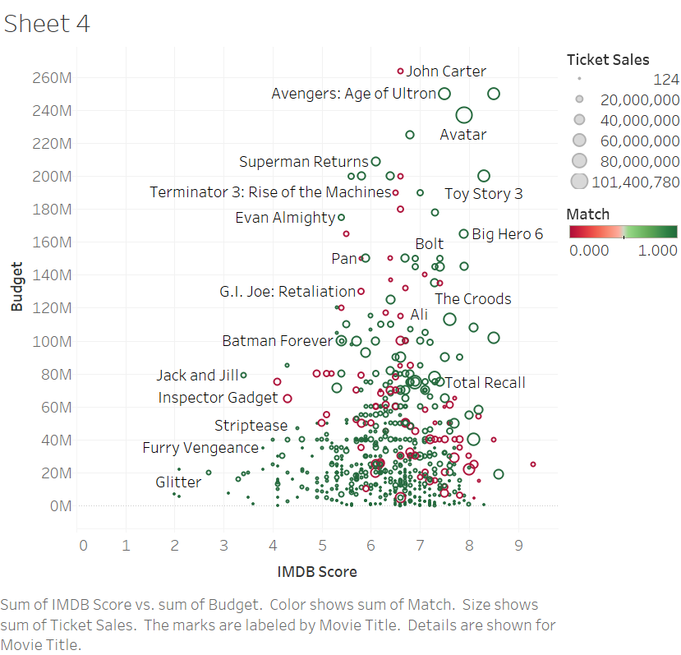
Analysis – Logit Regression
We used regression analysis to determine what factors contribute to a movie’s box office revenues.
Hit Rate = 84%
Test set (20% of data)
Training set (80% of data)
Logit regression on the success of each movie
Success = blockbuster movie with $100+ M in adjusted gross revenue
Goal: to predict which movies would be a blockbuster hit
Notes:
Karthik 3:00

Slide 13

Insights
Notes:
Noreen

Slide 14






Sony Picture Studios: 4th Quarter 2015 Releases
In looking at a sample of recent releases, we see how effective the model is in predicting whether or not a movie will be a blockbuster
Movie | Budget | Ln of Budget | # Critics for Reviews | Comedy | Drama | Sci-Fi | Family | # Voted Users | # Users for Review | IMDB Score | Blockbuster Prediction | Match?
 | $80M | $18.20 | 156 | 1 | 0 | 0 | 1 | 59,884 | 100 | 6.7 | YES
 | $33M | $17.31 | 36 | 1 | 0 | 1 | 0 | 6,063 | 30 | 5.9 | NO
 | $245M | $19.32 | 604 | 0 | 1 | 0 | 0 | 283,170 | 1,003 | 6.8 | YES
 | $25M | $17.03 | 154 | 1 | 0 | 0 | 0 | 34,274 | 87 | 6.5 | NO
 | $35M | $17.37 | 222 | 0 | 1 | 0 | 0 | 48,889 | 143 | 7.1 | NO
Notes:
After running both regressions and identifying exactly which variables are considered statistically significant towards our goal of predicting whether or not a film would gross over $100 M, we decided to test our model against a sample of recent releases.
Here are 5 fourth quarter releases for Sony Picture Studios from last year and their various significant factors, as determined by the models. As you can see on the right hand side, when compared to the actual gross revenue/blockbuster qualification, we were able to successfully predict whether or not the movie was going to be a blockbuster.
In looking at just one major studio’s releases in Quarter 4 last year, we can see how effective the model is in predicting whether or not a movie will be a blockbuster. Listing only the variables that the regression accounts for, the model derives an outcome of “YES” or “NO” for the blockbuster prediction. Comparing it to the actual ticket sale figures, we were 5 out of 5.

Slide 15
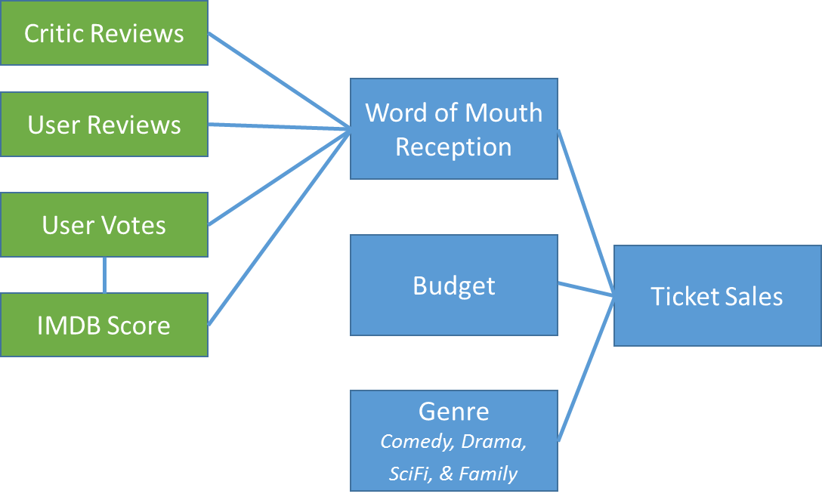
Factors that Govern Ticket Sales / Box Office Revenues
After identifying the variables that significantly effected the success of a movie, we adjusted our Mental Model accordingly
Significant Variables
New Mental Model
Insignificant Variables
Movie Budget
IMDB Score
Movie Genre: Comedy, Drama, Sci-Fi, and Family
User Engagement on IMDB: Number of User Votes and Number of User Reviews
Popularity of Cast
Popularity of Director
Number of Critic Reviews on IMDB
Movie Genres (excluding the 4 listed above)
Number of Faces in Poster
Movie Ratings
Notes:
This sample test along with our high hit rate of 84%, adjusted R squared of about 51%, and MAPE of 7.24%, gave us the confidence to narrow down the list of effective factors to the ones you see listed here on the left: the movie budget, the IMDB score, the movie genre if it was a comedy, drama, science fiction, or family movie, and the user engagement on IMDB.
Once we discarded the insignificant variables as shown on the right, we adjusted our mental model to identify only the significant actionable variables, realizing that factors such as cast popularity and number of faces in poster were not effective in predicting the success of a movie.
Noreen 2:00

Slide 16

Recommendations and Next Steps
Notes:
Elizabeth

Slide 17
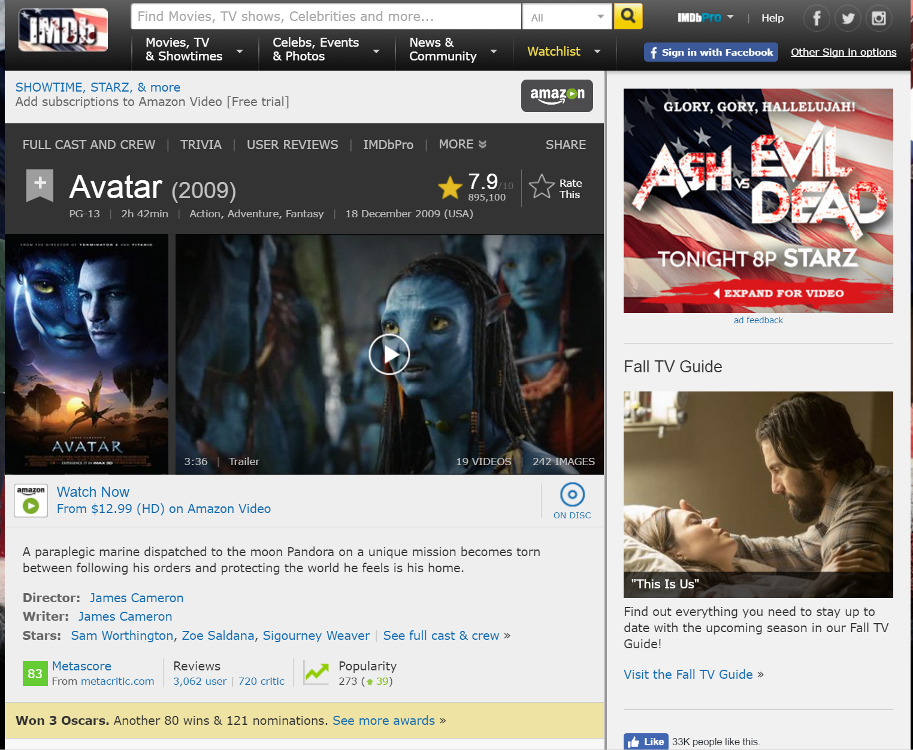
Recommendations and Next Steps
To further investigate the actionable variables that our regression highlighted, we have outlined additional strategic challenges
IMDB Score
What are the components of this rating?
Are there any early indicators of the IMDB score?
Can we test these indicators prior to the release of the movie?
Is there a way to incentivize additional users and critics to review a movie?
Movie Budget
IMDB Score
User Engagement on IMDB
Movie Genre
Notes:
Elizabeth

Slide 18

Questions?

